Slide 1
Bellman-Ford Algorithm

Slide 2
Problem of Dijkstra’s Algorithm?
Doesn’t work with graphs with negative cycle.
-1
A
B
-2
2
C

Slide 3
Bellman-Ford Algorithm
Finds shortest path from a single source vertex.
Works with negative edges or negative cycles.

Slide 4
Algorithm Description
Initialization
Take an array d[] to store distance from source.
Fill it with positive infinite value.
Initialize d[source] with 0.

Slide 5
Algorithm Description
Relaxation phase
Repeat V – 1 times:
For each edge (u,v) with cost w:
if d[v] > d[u] + w then update d[v] with d[u]+w

Slide 6
Algorithm Description
Negative cycle detection:
After V-1 iterations, check for any further updates in the distances.
If a vertex's distance still changes, it indicates the presence of a negative-weight cycle in the graph.

Slide 7
Complexity
O (V * E)

Slide 8
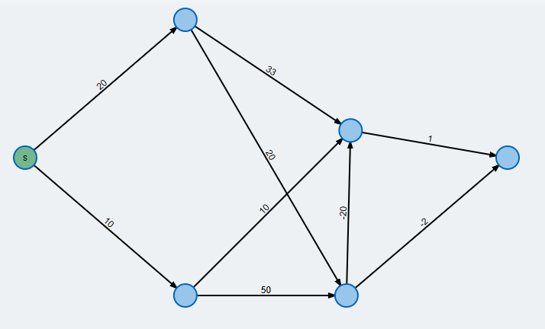
Example

Slide 9
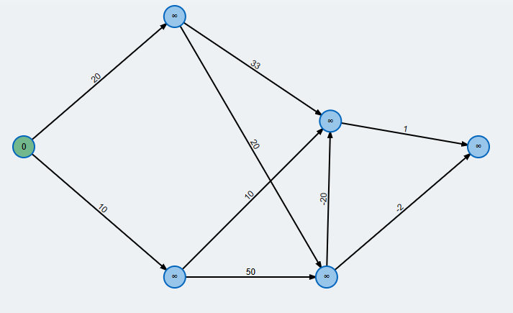

Slide 10
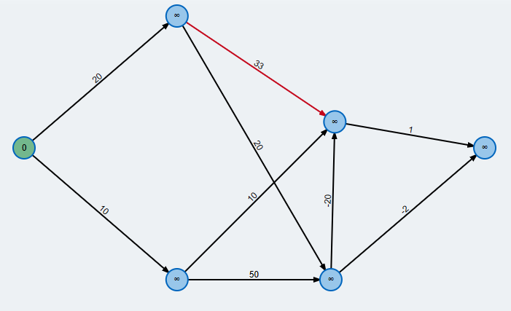

Slide 11
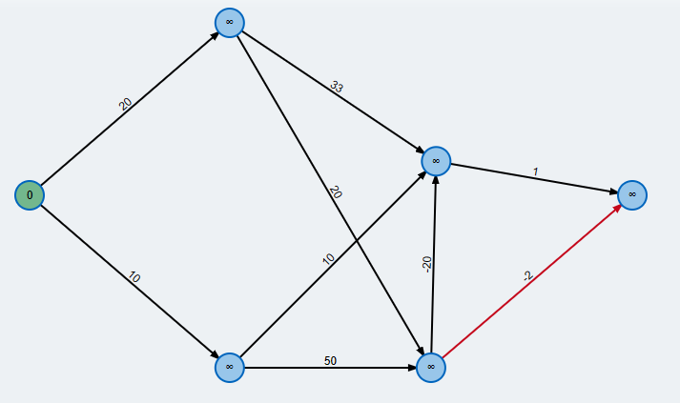

Slide 12
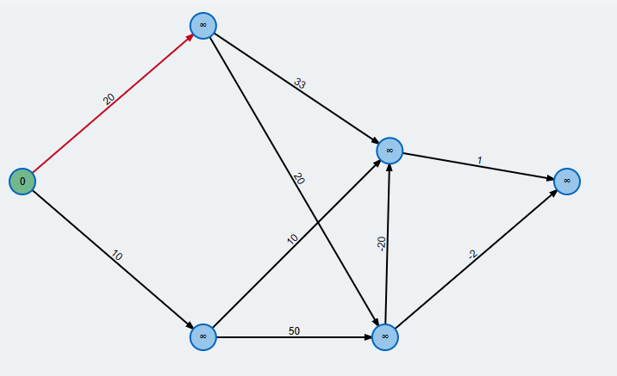

Slide 13
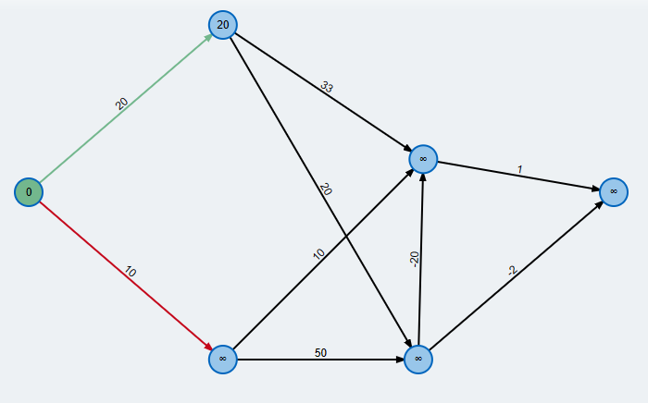

Slide 14
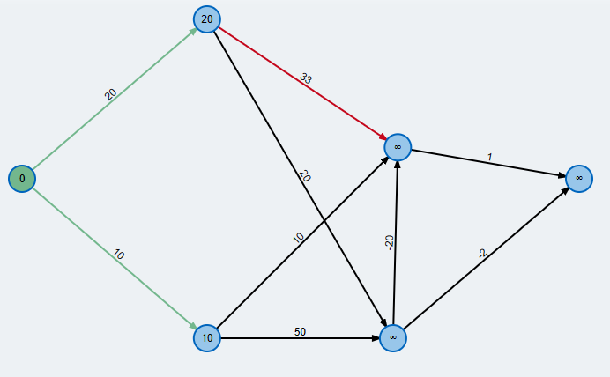

Slide 15
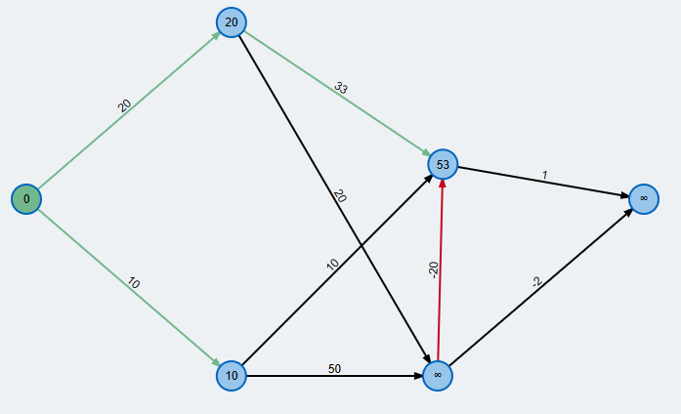

Slide 16
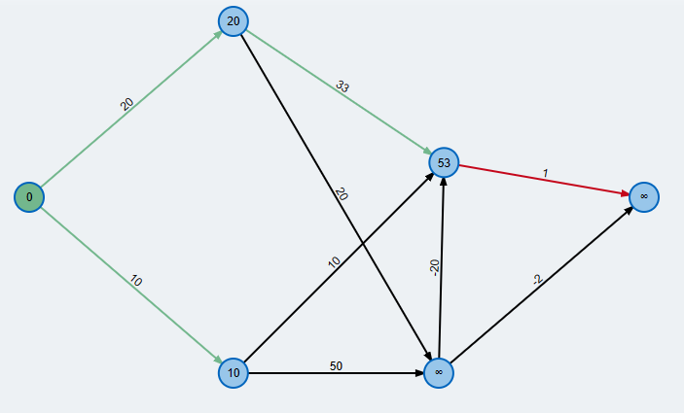

Slide 17
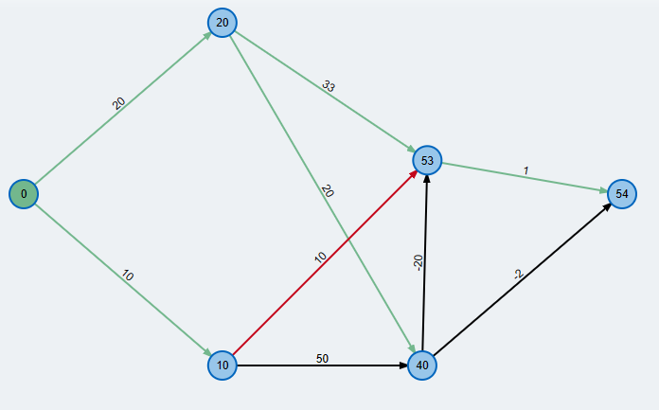

Slide 18
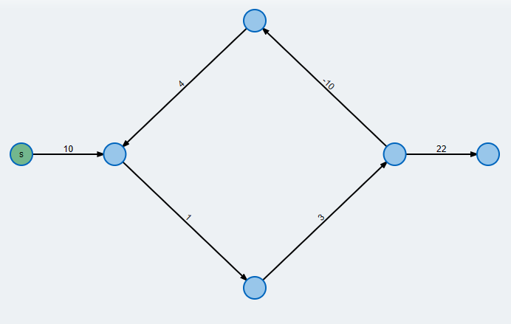

Slide 19
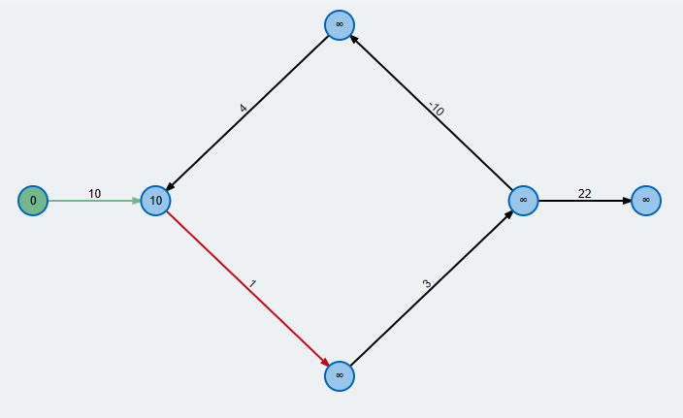

Slide 20
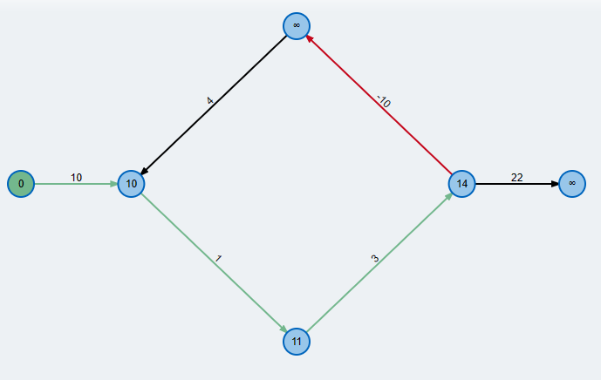

Slide 21
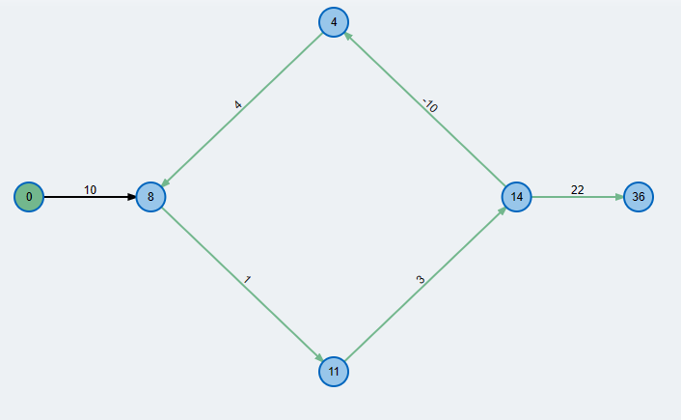

Slide 22
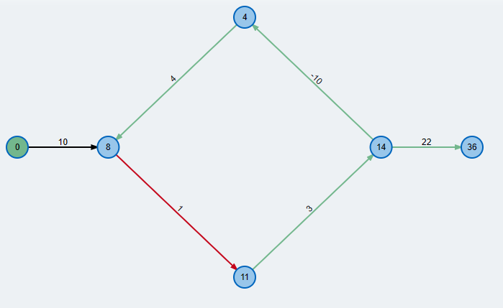

Slide 23
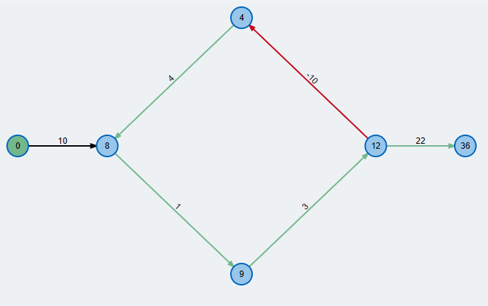

Slide 24
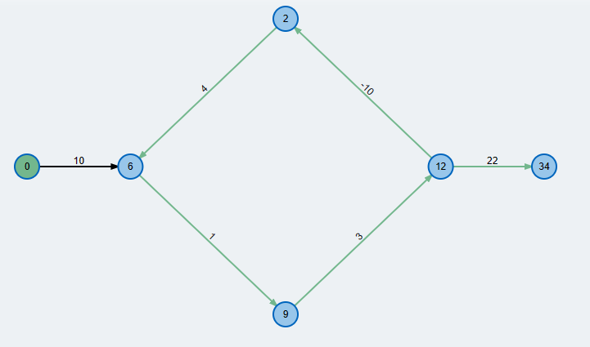

Slide 25
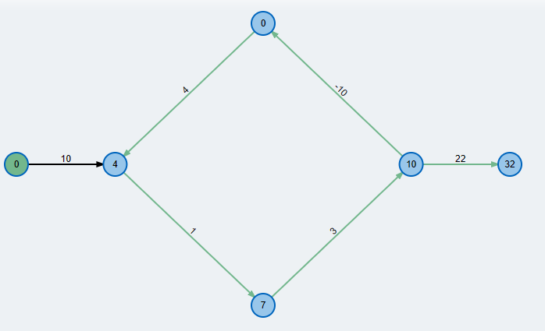

Slide 26
